Slide 1
LEGAL SATHI
Team September

Slide 2


INTRODUCTION

Slide 3
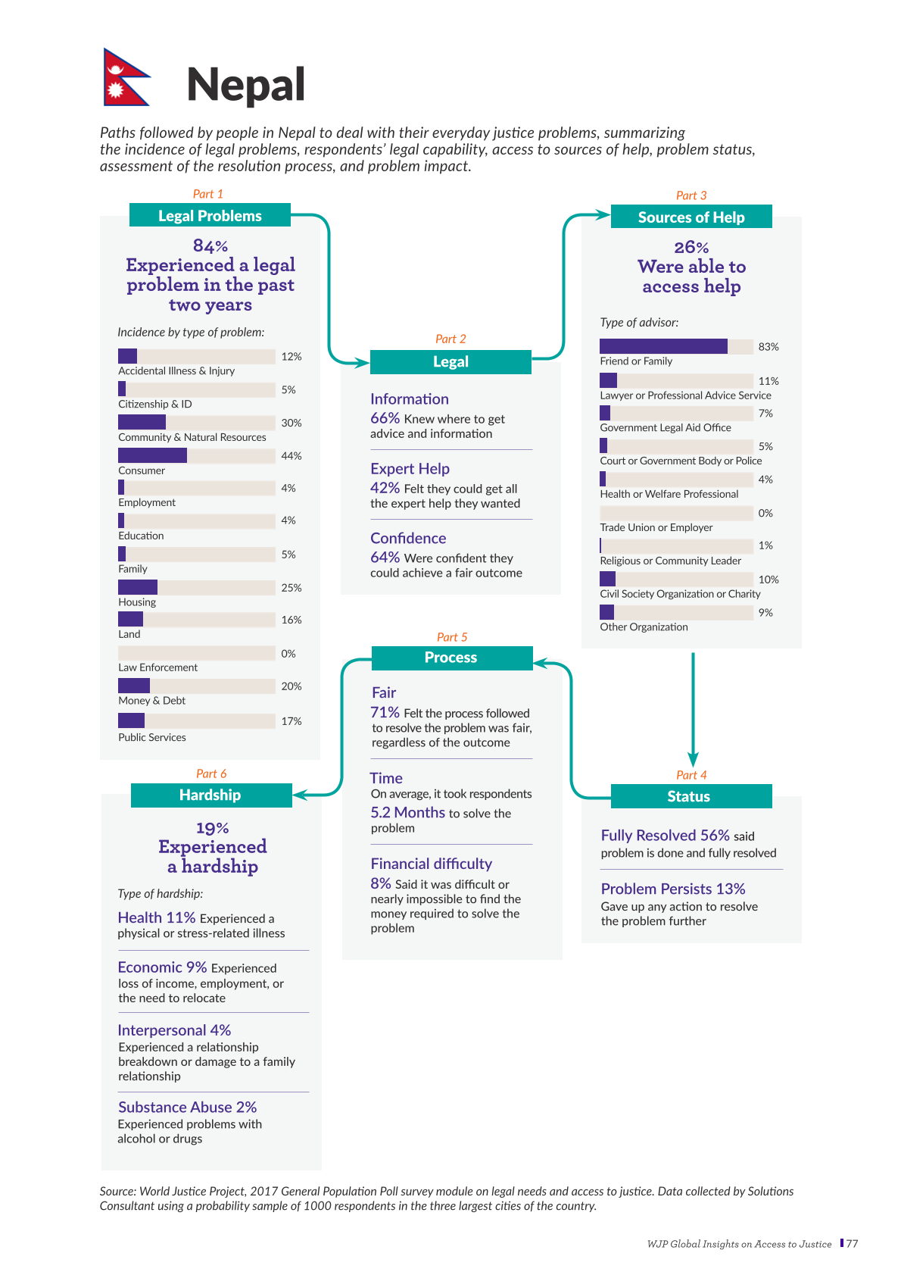
PROBLEM STATEMENT
Source: World Justice Project, 2017 General Population Poll survey module on legal needs and access to justice. Data collected by Solutions Consultant using a probability sample of 1000 respondents in the three largest cities of the country.

Slide 4
PROBLEM STATEMENT
Source: World Justice Project, 2017 General Population Poll survey module on legal needs and access to justice. Data collected by Solutions Consultant using a probability sample of 1000 respondents in the three largest cities of the country.

Slide 5


Features
Summarization
Scalability
Using RAG and Together AI’s open-source approach, the chatbot can scale across regions, legal systems, and languages, ensuring easy maintenance and adaptability.
Adaptive legal document summarization that simplifies complex legal language, making it easier to understand and apply the laws effectively.

Slide 6

IMPACTS
"Our chatbot democratizes legal access by providing immediate guidance to individuals who can't afford a lawyer, serving as a crucial resource in regions with limited legal services, and helping law firms streamline routine tasks, saving valuable time.

Slide 7
TECHNICAL ASPECT
Front End - React
Back End - Fast Api
RAG(Retrieval Augmented Generation) as NLP Framework

Slide 8
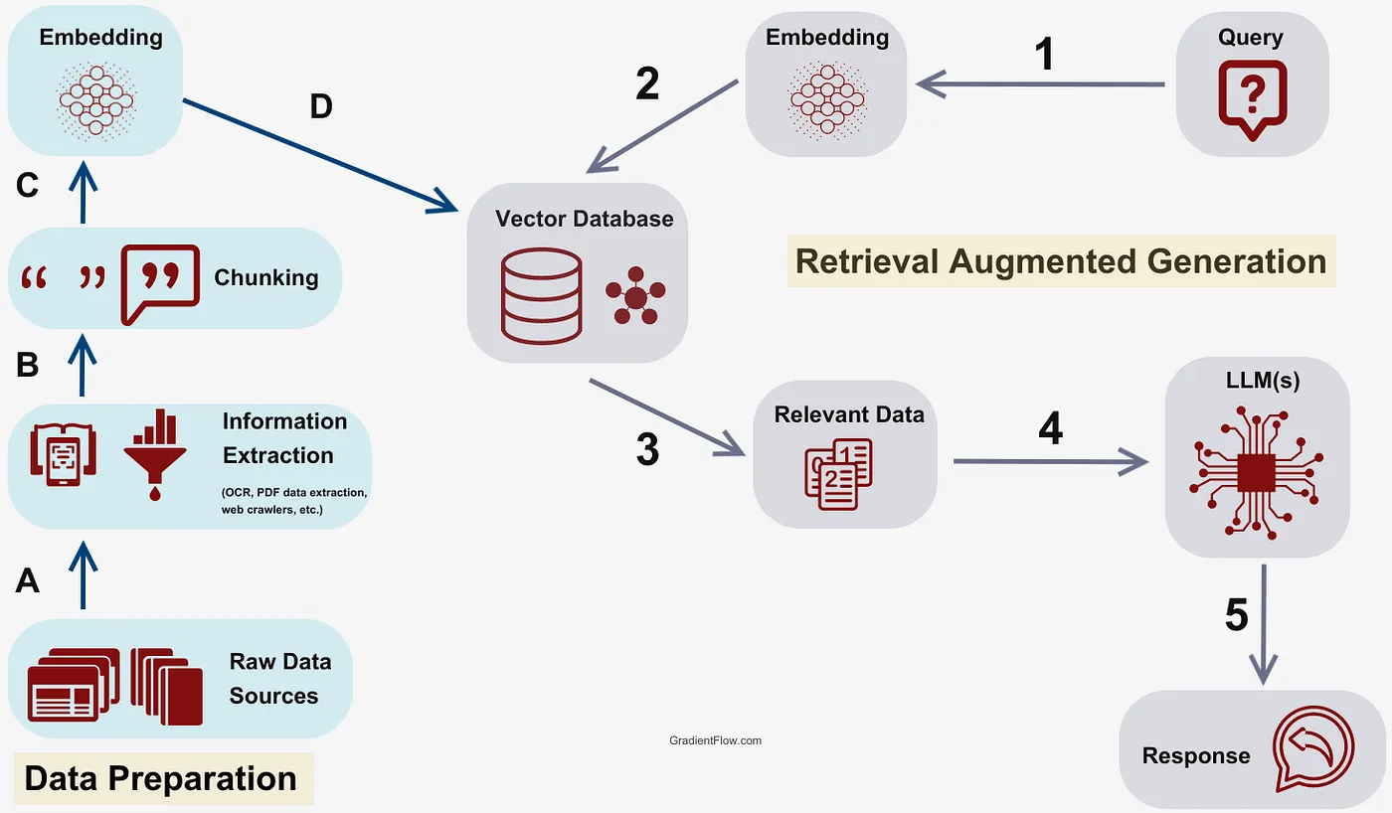

Slide 9

DEMO

Slide 10
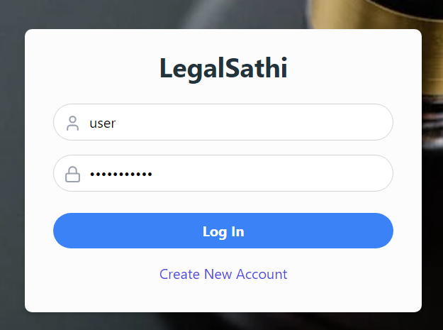
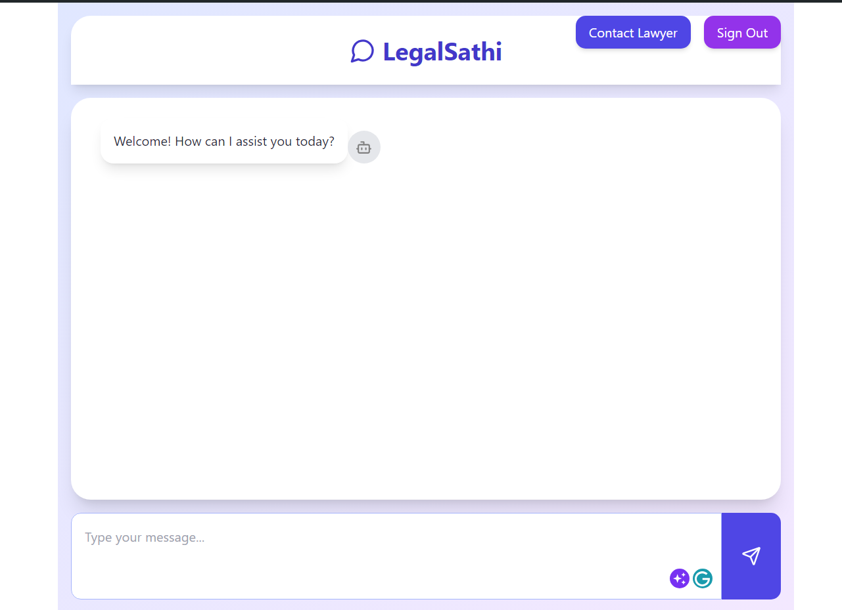
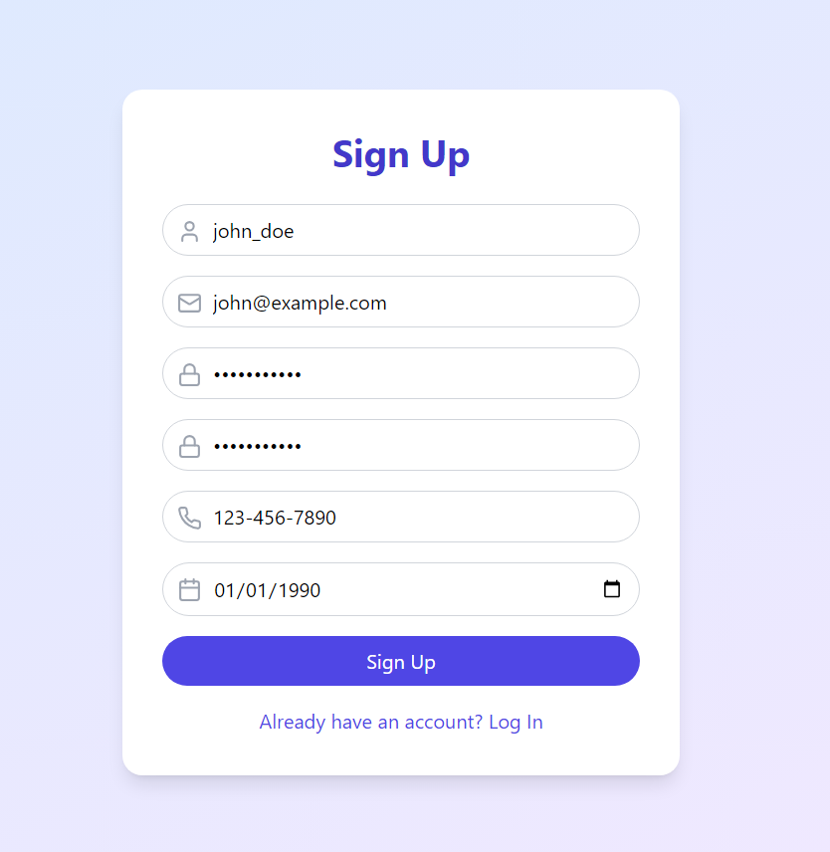

Slide 11
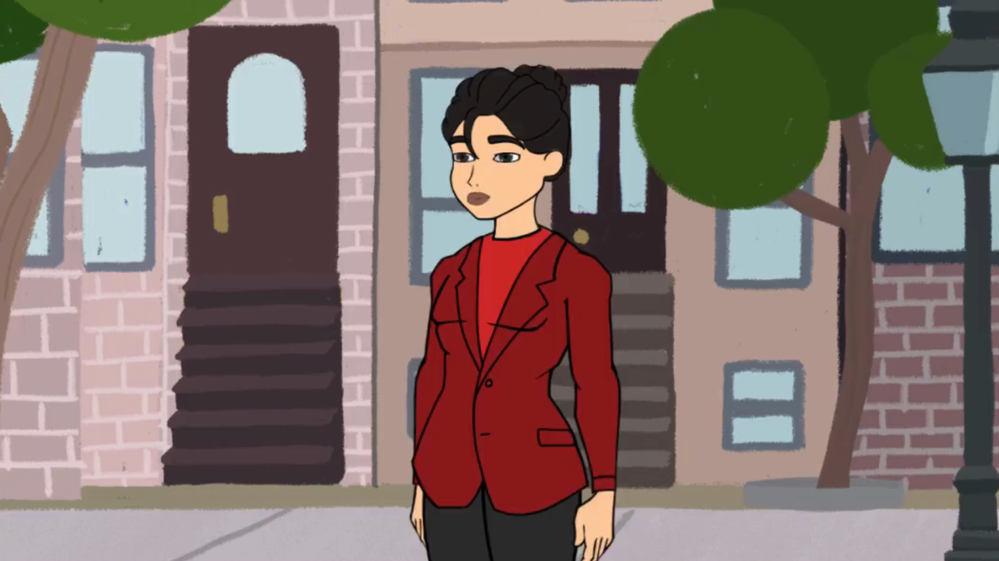

Slide 12
THANK YOU

